Slide 1
Equity Scan: Theory of Change and Action Planning Session
LDSS Family of Schools – March 19, 2019

Slide 2
Appears representative
The common theme seemed to be lack of communication
I think after reading the feedback from the LDSS Family of Schools session; there is a lot of work needing to be done in terms of equity for indigenous learners in the schools, as well the relationship between schools and parents, and bands and parents. There still needs to be work in incorporating indigenous values and teachings into the mainstream school.
It's interesting to read about other's perspectives. I definitely think educating the educators is a wonderful idea as we all have so much more to learn here. Everyone needs to be on the same page and clearly we aren't.
Some great thoughts.
I read through and see a lot of concerns from either the parents and the Band reps(Education coordinators).
Responses were pretty precise.
How it would be taken into the next steps and the on going support for it
Looks good. Nice to get feedback from a variety of stake holders.
There are good ideas
Still a long way to go. Initial steps are being taken. More cooperation and feedback required between different groups/partners.
Overall, the feedback tells us that we have some work to do, especially with policy and governance. It was apparent, though, that some of the stakeholders are not aware of the positive measures that are being taken in the Learning Environment and Pedagogical Core domains.
We have a lot of work to do.
Sustained change is hard.

Slide 3
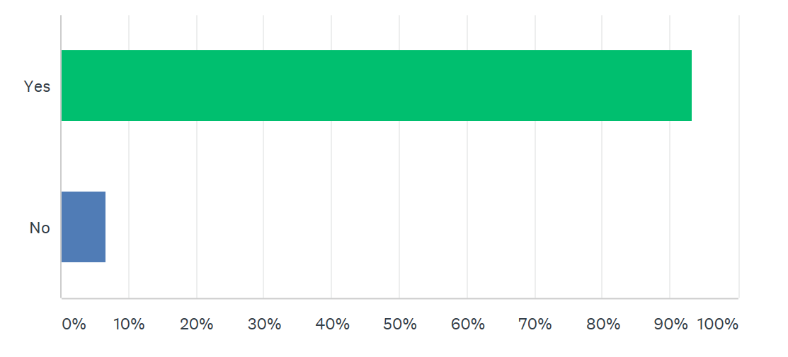

Slide 4
Focus staff level of comfort/understanding with Aboriginal Ways of Knowing and First People's Principles - what does that actually look like in practice.
Trying to increase communication, particularly with the teachers and support staff on the front lines.
I think having the students/parents become apart of the decision makers in the Aboriginal Education in the schools. They should be partners somehow, and not just band representatives.
We need certified/qualified Language and Culture teachers in our schools. We also need to find a way to have more parent involvement within the schools.
More communication between stakeholders
More Language and Cultural teaching.
Getting all youth involved and fully aware.
When would this be implemented into the system.
1. Finding ways to get First Nation community members into the schools (so they feel more connected). 2. Having workshops so staff can better learn how to integrate First Nation content into their classrooms.
Getting families involved, and putting time aside for more cultural learning
Forming a cohesive and committed group that represents all partners, that focuses on improving learning environments and policies for all students.
The first step could be Learning Profile. We need support with collecting and reviewing data so we can identify students who need support/intervention. We can have all the policies in place but we need action that connects the dots directly to the learners!
Communication and training to all support workers, that work with Indigenous students. This could definitely help students reach the Graduation target. Pro-d days benefit all professionals whom work with all of our students. Policies and procedures need to be shared with all staff, so they are aware.
I think further study is needed. We need to track individual students from early grades on and identify stumbling blocks and impediments to success. We also need to reach out to districts that have implemented successful responses to these challenges.

Slide 5
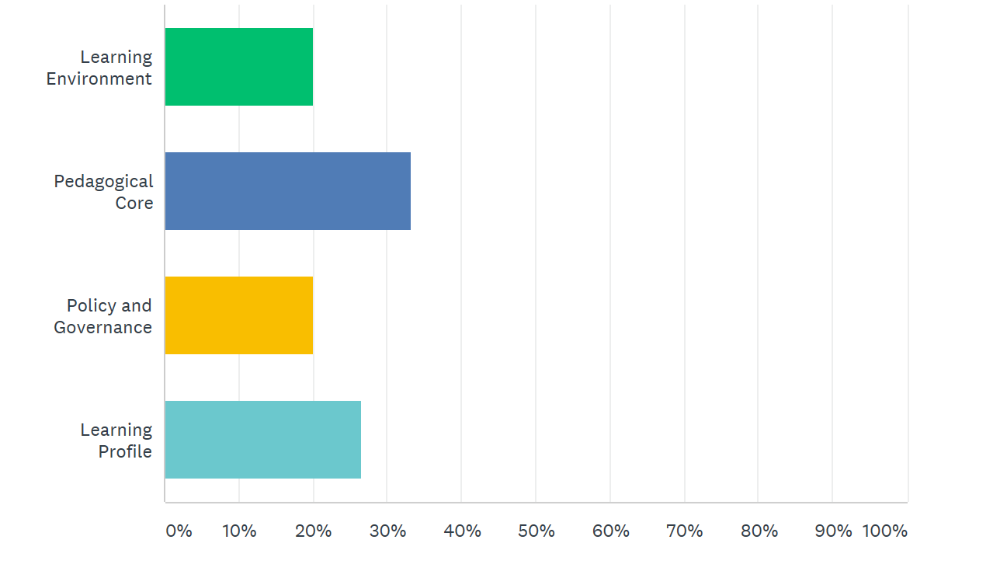

Slide 6
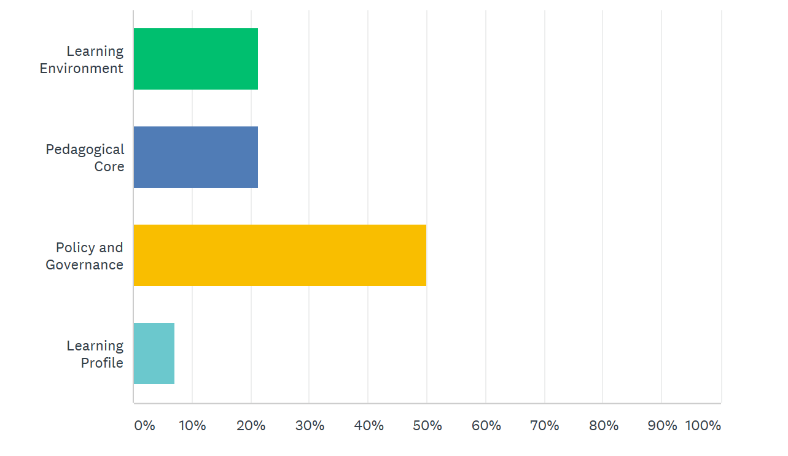

Slide 7
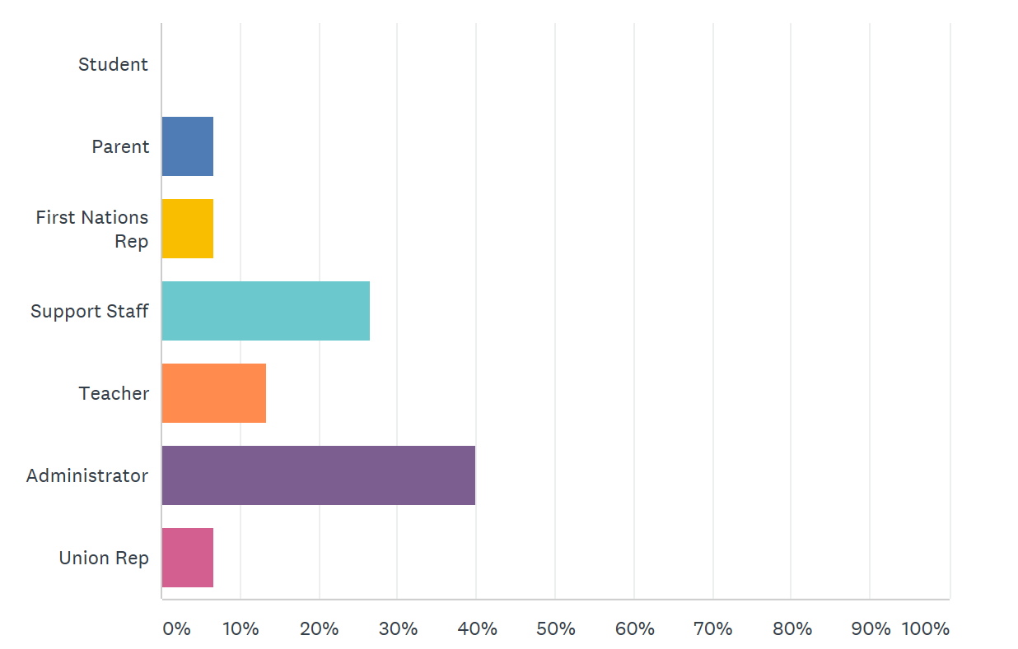

Slide 8
Next Steps: Theory of Change
____________________________________________________________________________________________________________________________________________________________________________________________________________________________________________________________________________________________________________________________________________________________________________________________________________________________________
Action Plan:
______________________________________________________________________________________________________
______________________________________________________________________________________________________
______________________________________________________________________________________________________
______________________________________________________________________________________________________
______________________________________________________________________________________________________

