Slide 1
Equity Scan: Theory of Change and Action Planning Session
NVSS Family of Schools – March 14, 2019

Slide 2
That there is still a lot if work to be done
The feedback was good. Some interesting trends. Looks like we have some work to do.
My initial thoughts were that we have a ways to go in terms of equity. I thought there were some interesting points made in the feedback to the scanning questions.
There were some interesting and surprising data

Slide 3
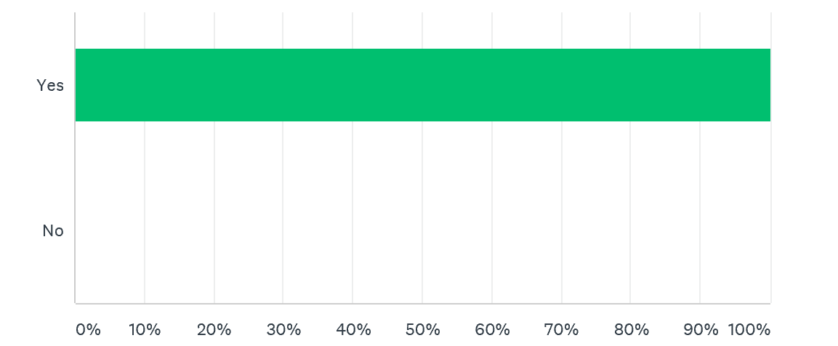

Slide 4
More parental involvement
Working with local communities
I think that stronger efforts to involve community would be an impactful change. As schools and educators work to embed Aboriginal Worldview into curriculum and learning, the involvement of local FN community members build relationships and creates authentic learning experiences for learners. I also think that more staff (CUPE included) need to be aware of FPPL via professional development.
More training

Slide 5
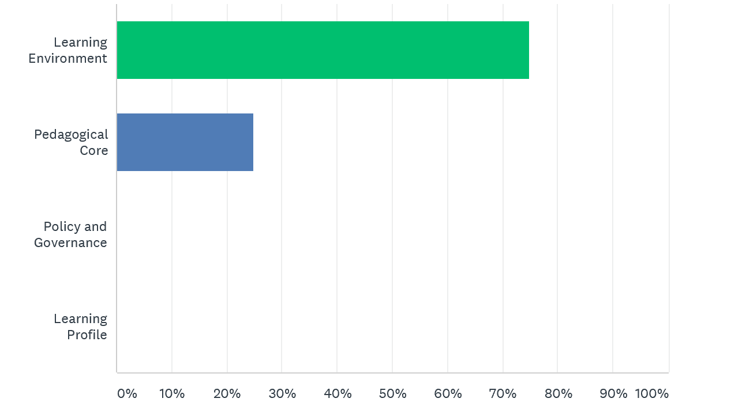

Slide 6
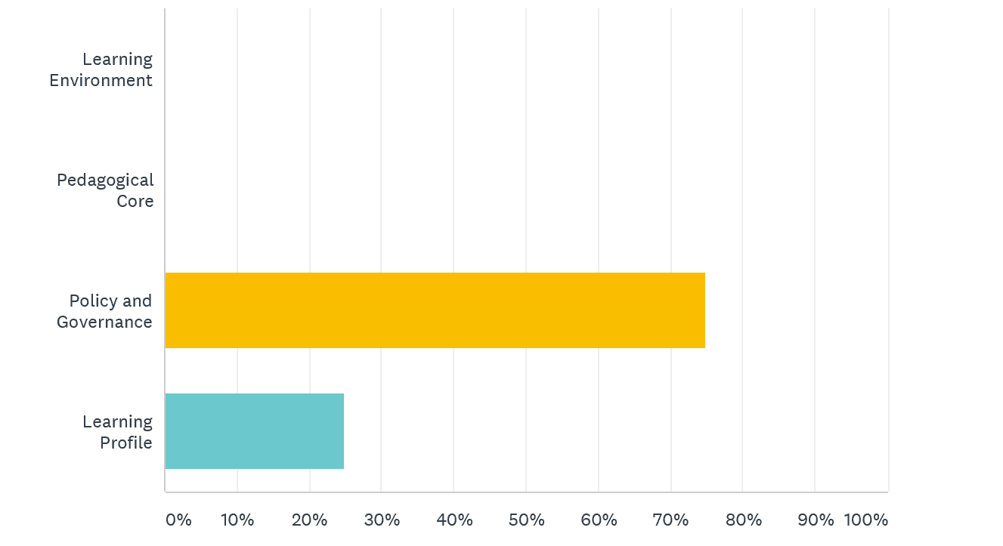

Slide 7
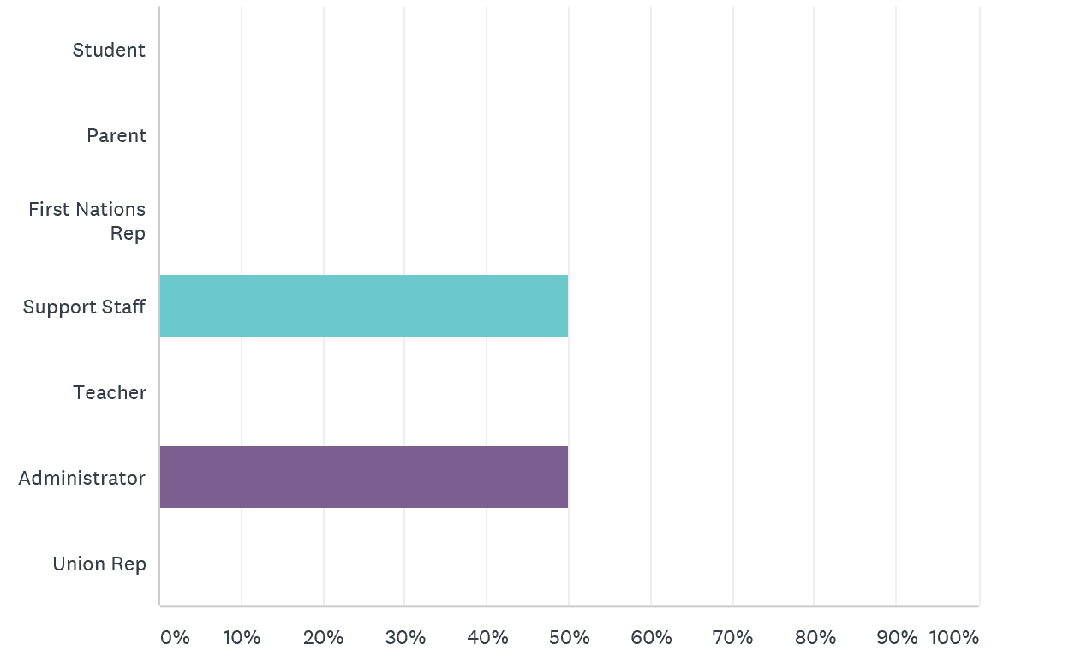

Slide 8
Next Steps: Theory of Change
____________________________________________________________________________________________________________________________________________________________________________________________________________________________________________________________________________________________________________________________________________________________________________________________________________________________________
Action Plan:
______________________________________________________________________________________________________
______________________________________________________________________________________________________
______________________________________________________________________________________________________
______________________________________________________________________________________________________
______________________________________________________________________________________________________

