Slide 1
LDSS Equity Scan
November 14, 2018

Slide 2
Territory recognition
We recognize that we live, work and play within the territories of the surrounding 6 Nations: Burns Lake Band, Cheslatta Carrier Nation, Lake Babine Nation, Nee Tahi Buhn Band, Skin Tyee First Nation and Wet’suwet’en First Nation. It is an honour to be here today.

Slide 3
Introductions

Slide 4
Courageous Conversations - Norms
Stay Engaged
Speak Your Truth
No Fixing
Experience Discomfort
Take Risks
Listen for Understanding
Expect and Accept non-closure
source: Cultures Connecting, Dr. Caprice Hollins and Ilsa Govan, adapted from the work of Singleton and Linton (2006)

Slide 5
What we mean by Equity?
As Fairness…
Removes obstacles to success such as family background and socio-economic circumstances from the educational experience of learners and the narratives of professional practice.
As Inclusion…
Ensures that all students cross our graduation stages with dignity, purpose and options.
Ensures that nobody is left out because of
who they are and from where they come.
= Equity of Opportunity
Source: OECD. Promising Practices in Supporting Success for Indigenous Students. August, 2017.

Slide 6
Equity is about WHO we are as educators
and what we commit to changing
“What are we leading?”
Racism of low expectations;
Implicit bias and privilege;
Deficit thinking and theorizing;
One size fits all planning and organizing for learning; and,
Silence in the face of all of the above

Slide 7
Accelerated Success
Non-Aboriginal
Aboriginal
2000
2005
2010
2015
2016
2017
2018
2019
2020

Slide 8
Expanding the Focus for Equity
Prince Rupert
Nechako Lakes
Prince George
Williams Lake
North Okanagan Shuswap
Kamloops Thompson
Vancouver
North Vancouver
Surrey
Burnaby
Sooke
Saanich
Gulf Islands
Port Alberni
Vancouver Island North
Kootenay Lakes
SD82 Coast Mountains
SD28
Quesnel
SD59
Peace River South
SD23
Central Okanagan
SD37 Delta
SD68
Nanaimo Ladysmith
1. Create a District Equity Scanning Team
5. Define Goals and Set Equity Action Plans
2. Conduct
Equity Scan
4. Develop Theory of Change
3. Create District Equity
Profile

Slide 9
Equity Scan Teams
Unique to each district
Inclusive and broad community
representation. “Who isn’t here that should
be?”
Guide the process and work collaboratively to determine Action Plans and Goals
A place for candour and truths

Slide 10
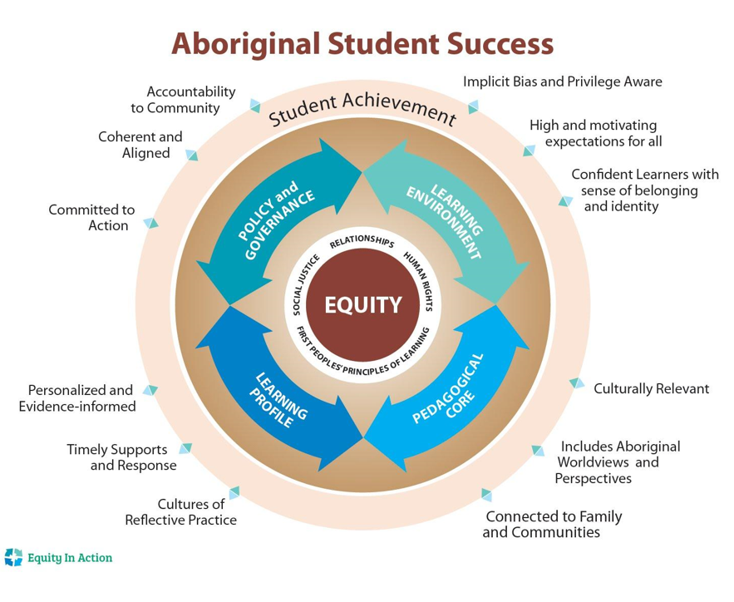
Our district team
Jason Alexis – Saik’uz First Nation
Monty Palmantier – Lake Babine Nation
Mark Prince – Nak’azdli Band
Jonathan Morry – Teacher BESS
Melissa Gagnon-Prince – AbEd Worker GPE
Wendy Keleman – WKE Principal
Suzanne Burck – DHE Principal
Heidi Grant – LDSS Principal
Ken Young – NVSS Principal
Craig Houghton – FSJSS Principal
Brian Cross – FLESS Principal
Megan Boniface – EBUS Vice Principal
Leona Prince – District Principal AbEd
Claire McKay – Director of Instruction
Manu Madhok – Superintendent of Schools
Trustee and Union Reps

Slide 11
Guided Inquiry
Equity Scanning is about going deeply into the culture and norms of the district.
Questions and rubrics are designed to be points of inquiry that Equity Teams worth through.
Will indicate areas of strength and areas of
concern to be addressed.

Slide 12
Building the Equity Scan Profile
The main work of Equity Teams.
The result of broad and meaningful consultation and inquiry.
A “Makes Sense” inventory of where we are.
Sets the stage for Action Plan and areas of growth.

Slide 13
Equity Action Plan
The final expression of Equity Scan.
Makes a commitment to growth and change.
Is an honest and courageous document that is
accessible to all partners.
Addresses the inputs gathered during scanning.

Slide 14
Learning Profile
As close to real time as possible information
about student learning.
PEN level record of the educational experience of learners.
Names of students that are included in your 6-
Year Completion count that have not graduated.
FSA profile of the district that can be used for resourcing.
Used in conjunction with classroom and district
assessments.

Slide 15
A Provincial Parity Lens (inspired by Dr Airini and Sereana)

Slide 16
School District Parity Sample

Slide 17
Student Learning Profile Sample

Slide 18
Equity Scan Guiding Questions
Table Talk Sessions

Slide 19
Workbook Questions - Samples
Learning Environment
How are families and communities made to feel welcome and valued as part of the learning Environment?
How are families informed about the curriculum, teaching practices and graduation
requirements impacting their students?
What are the stories told about the schools and districts at the community level?

Slide 20
Workbook Questions - Samples
Pedagogical Core
Is there practice and decision-making that demonstrates a value shift from equality to equity?
How are Aboriginal Worldviews and Perspectives incorporated into the daily experience of
Learners?
Are issues of implicit bias and racism raised and addressed as possibly impacting the nature of Instruction, assessment and learning for Indigenous learners?
What opportunities are there for students, families, and communities to learn about and give feedback on effective instruction, curriculum, and resources that are used in the classroom?

Slide 21
Workbook Questions - Samples
Policy and Governance
Does the district have in place policy or agreements that reflect a dedication to equity in budgets, employment/hiring and specific service to Indigenous learners.
Does your district have an Indigenous parent, family and community engagement policy or strategy?
Does your district have specific policy related to access to indigenous language and cultural programs?

Slide 22
Reality Check – Lessons Learned

Slide 23
Next Steps: A Collaborative Approach
Timeline 2018/2019
Build Equity Networks & Monthly Connections
Schedule Learning Profile Support(s)
Second Field Liaison visit (March – April 2019)
Q & A

