Slide 1
Equity Scan: Theory of Change and Action Planning Session
FLESS Family of Schools – March 18, 2019

Slide 2
While progress has been made in regards to community engagement, we must continue to strengthen our relationship. We still don't have language programs, how can we address that deficit?
We have some work to do
We've got a long way to go in a lot of areas. It looks like a good start and the meeting was successful, but we need to create a really solid foundation and go forward from there.
My thoughts are that we as parents aligning with the teachers can successfully help all students attain their high school diploma.

Slide 3
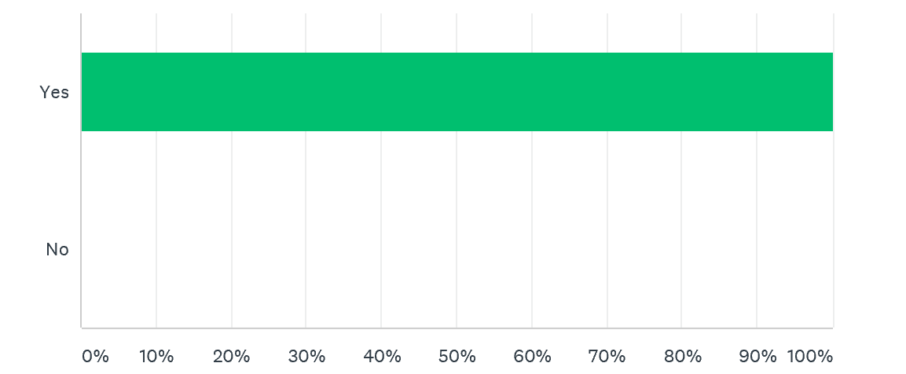

Slide 4
Finding ways to connect school with community. Building a strong relationship would address many of the challenges we face as a system. Communication/Understanding, language, culture etc
Better understanding and integration of the First People's Principles of Learning could be valuable.
Continue to develop mechanisms to increase involvement between the stakeholder groups
Parents along with the teachers can help biuld the students confidence And find their inner strengths, thus will help them find themselves and they will take their confidence and succeed.

Slide 5
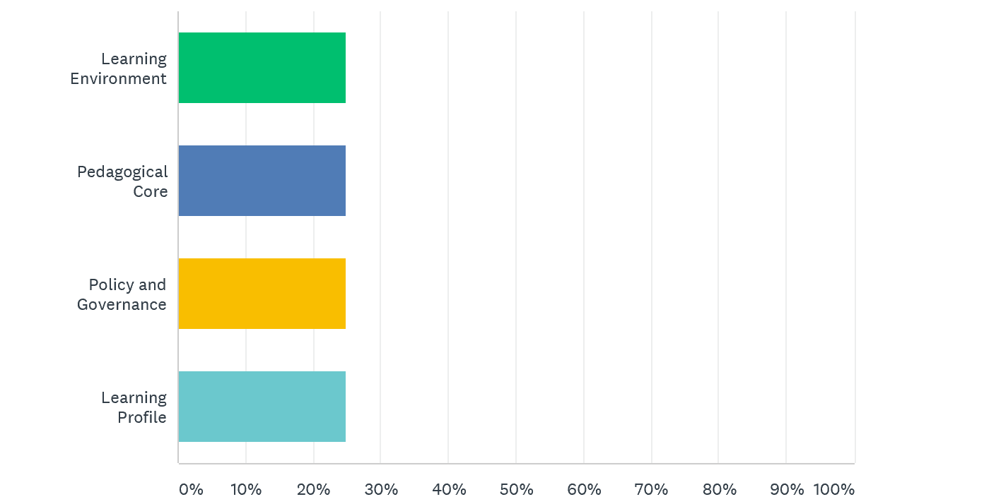

Slide 6
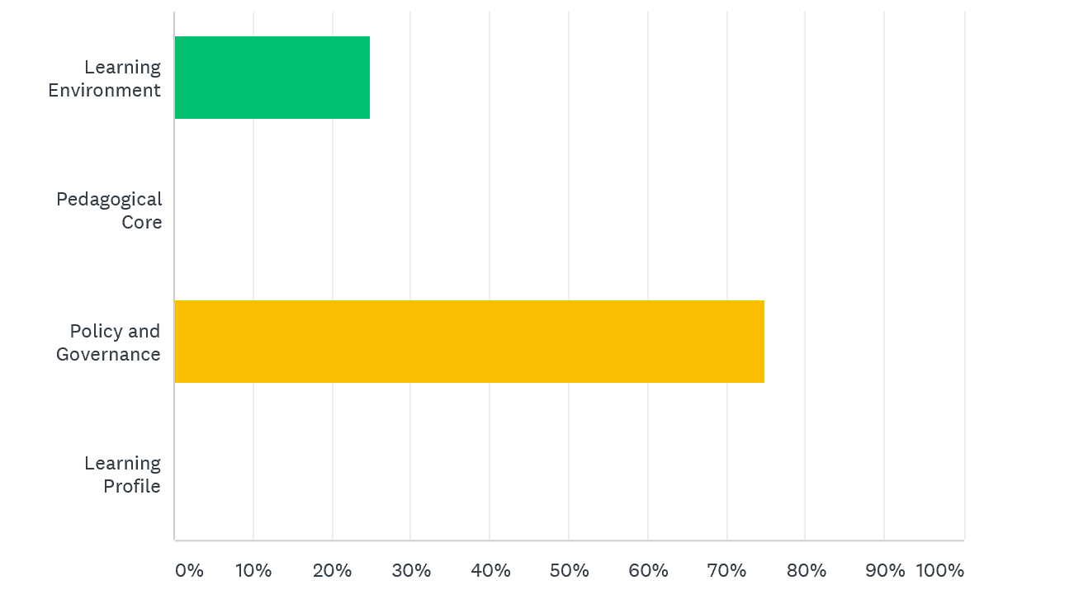

Slide 7
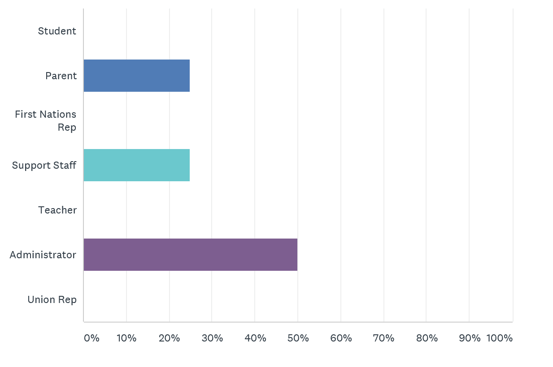

Slide 8
Next Steps: Theory of Change
____________________________________________________________________________________________________________________________________________________________________________________________________________________________________________________________________________________________________________________________________________________________________________________________________________________________________
Action Plan:
______________________________________________________________________________________________________
______________________________________________________________________________________________________
______________________________________________________________________________________________________
______________________________________________________________________________________________________
______________________________________________________________________________________________________

