Slide 1
Indigenous-Focused Graduation Requirement
SECTOR PARTNERS PRESENTATION
April 2022

Slide 2
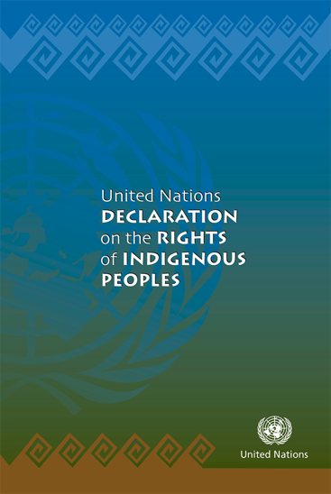
Background – Declaration Act
The Declaration on the Rights of Indigenous Peoples Act establishes the UN Declaration on the Rights of Indigenous Peoples as the framework for reconciliation.
The Act commits govt to develop and implement an action plan in consultation and cooperation with Indigenous peoples – to achieve objectives of the UN Declaration in B.C.
The Action Plan includes a commitment to: “Implement a mandatory course or bundle of credits related to First Peoples as part of graduation requirements in B.C.”

Slide 3
Background – Truth, Reconciliation, & Anti-Racism
Draft Principles
Minister Mandate Letters
Indigenous–Focused Grad Requirement
Reconciliation is a fundamental and ongoing process and requires a distinctions-based approach.
Include expectations to support lasting and meaningful reconciliation, equity and anti-racism.
Part of a broader Indigenous-specific anti-racism and discrimination strategy in development for K-12.

Slide 4
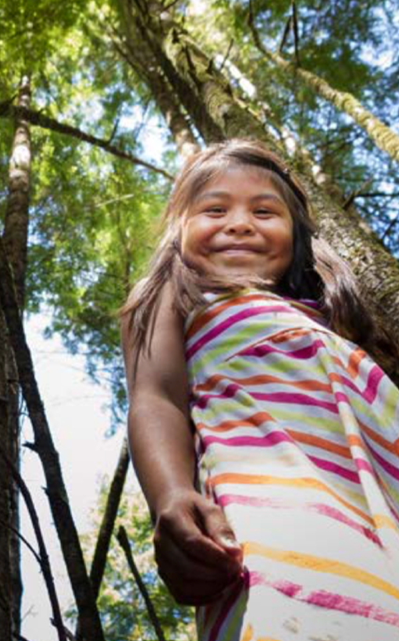
Indigenous Curriculum Content
B.C. has been a leader in ensuring Indigenous worldviews, perspectives, histories, and cultures are represented across the redesigned provincial curriculum.
Introduction of an Indigenous-focused grad requirement is an important next step towards Truth and Reconciliation, and supports our commitment to develop the “Educated Citizen”
Supported by numerous partners, including BCTF, BCSTA and BC Association of Institutes & Universities
4

Slide 5
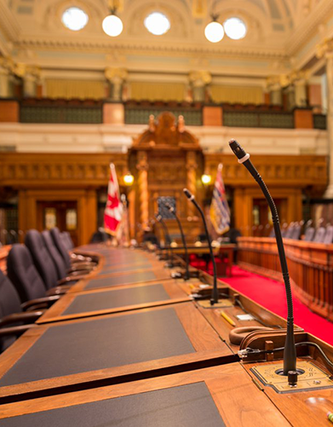
Government Direction
Implement a mandatory course or bundle of credits on First Peoples as a graduation requirement in B.C.
Engage with Indigenous communities, the education sector, and the public on how to implement this new graduation requirement.

Slide 6
Proposed Model
Successful completion of:
No increase to total number of credits required for graduation
Some existing provincial courses could meet multiple graduation requirements (e.g., BC First Peoples 12 could meet Social Studies 11/12 requirement, and the new requirement)
One of a variety of provincially-developed courses - OR
A First Nations Language course at the 10-12 level - OR
A locally-developed, Indigenous-focused course (BAA)
6

Slide 7
Current Courses Meeting Requirement
Require students to complete 4 credits from the following:
English First Peoples Writing 10*
English First Peoples Literary Studies 10*
English First Peoples New Media 10*
English First Peoples Spoken Language 10*
English First Peoples Literary Studies & Writing 11
English First Peoples Literary Studies & New Media 11
English First Peoples Literary Studies & Spoken Language 11
English First Peoples 12
BC First Peoples 12
Contemporary Indigenous Studies 12
Any First Nations language course in grades 10-12
Locally-developed, Indigenous-focused BAA course in grades 10-12
* 2 CREDIT COURSE – WOULD MEET HALF OF THE REQUIREMENT

Slide 8
Provincial Course Content
English First Peoples 10, 11 and 12
Focus on diverse experiences, values and beliefs of Indigenous peoples through variety of authentic Indigenous texts in a range of media (e.g. story, song, poetry)
Support students to build understanding of self and other, communicate effectively and think critically in a variety of contexts
FNESC teacher resource guide available to support respectful implementation of these courses
BC First Peoples 12
Focuses on how Indigenous peoples’ identities, worldviews and languages are connected to the land, the continued impact of colonialism on Indigenous peoples, and the richness and diversity of Indigenous cultures
Explores how Indigenous peoples in BC are challenging ongoing colonialism through self-governance, leadership and self-determination
FNESC teacher resource guide in development for this course
8

Slide 9
Considerations for Effective Implementation
Addressing educator capacity and needs
Ensuring continued delivery of Indigenous content in other subjects and grade levels
Experiences of Indigenous learners, their families and communities
Communications to students, parents and partners, including implications for electives (choice) and post-secondary transitions
Situating within overarching anti-racism strategy

Slide 10
2024
2023
Implementation Timing
Consultations (March 7 to April 22, 2022)
K-12 Sector
Indigenous communities
Public
Implementation model finalized - August 2022
Target implementation is 2023/2024
Students graduating in the 2023/24 school year must meet new requirement
2022
2021
2020
2019
10

Slide 11
Implementation Timing for Students
If I’m currently in Grade 9
In 2021/22 (Grade 9) - Not applicable
In 2022/23 (Grade 10) - May complete requirement early
In 2023/24 (Grade 11) - May complete requirement before entering Grade 12
In 2024/25 (Grade 12) - Must complete the requirement to graduate
If I’m currently in Grade 10
In 2021/22 (Grade 10) - May complete the requirement early
In 2022/23 (Grade 11) - May complete the requirement before entering Grade 12
In 2023/24 (Grade 12) - Must complete the requirement to graduate
If I’m currently in Grade 11
In 2021/22 (Grade 11) - Encouraged, but no requirement
In 2022/23 (Grade 12) - Encouraged, but no requirement (if all other grad requirements met)
If I’m currently in Grade 12
In 2021/22 (Grade 12) - Encouraged, but no requirement (if all other grad requirements met)
11

Slide 12
Discussion Questions
?
What advice can you offer regarding how best to implement this change to the graduation program? Any suggested improvements to the proposed model?
What will educators and other school/district staff (e.g., counsellors, administrators) need to effectively implement this graduation requirement for 2023/24?
What information and supports will students and parents need?
Any additional questions or comments?

Slide 13
Complete consultations with K-12 sector, Indigenous communities and public
Utilize feedback from consultations to inform “What We Heard” report & updates to the proposed model
Next Steps
Finalize and announce implementation plan

Slide 14
Thank you.

