Slide 1
Equity Scan: Theory of Change & Action Planning Session
LDSS/FLESS/NVSS/FSJSS Family of Schools
March 19, 2019

Slide 2
LDSS RESPONSES TO Q#1:
Appears representative
The common theme seemed to be lack of communication
I think after reading the feedback from the LDSS Family of Schools session; there is a lot of work needing to be done in terms of equity for indigenous learners in the schools, as well the relationship between schools and parents, and bands and parents. There still needs to be work in incorporating indigenous values and teachings into the mainstream school.
It's interesting to read about other's perspectives. I definitely think educating the educators is a wonderful idea as we all have so much more to learn here. Everyone needs to be on the same page and clearly we aren't.
Some great thoughts.
I read through and see a lot of concerns from either the parents and the Band reps(Education coordinators).
Responses were pretty precise.
How it would be taken into the next steps and the on going support for it
Looks good. Nice to get feedback from a variety of stake holders.

Slide 3
CONTINUATION OF LDSS RESPONSES TO Q#1 :
There are good ideas
Still a long way to go. Initial steps are being taken. More cooperation and feedback required between different groups/partners.
Overall, the feedback tells us that we have some work to do, especially with policy and governance. It was apparent, though, that some of the stakeholders are not aware of the positive measures that are being taken in the Learning Environment and Pedagogical Core domains.
We have a lot of work to do, need for a common understanding.
Sustained change is hard. Speaks to complexity
Communication, Aboriginal Education Newsletter, success stories- see Q#14
Relationships with families and community.
Research Aboriginal Education
Non status, on reserve- school based
13 community meetings for findings, web portal.
Stakeholder voice: round table- how do we continue this structure? Why can’t we sustain it?
Lack of parent involvement- research about parent involvement.

Slide 4
FLESS RESPONSES TO Q#1 :
While progress has been made in regards to community engagement, we must continue to strengthen our relationship. We still don't have language programs, how can we address that deficit?
We have some work to do
We've got a long way to go in a lot of areas. It looks like a good start and the meeting was successful, but we need to create a really solid foundation and go forward from there.
My thoughts are that we as parents aligning with the teachers can successfully help all students attain their high school diploma.
NVSS RESPONSES TO Q#1 :
That there is still a lot if work to be done
The feedback was good. Some interesting trends. Looks like we have some work to do.
My initial thoughts were that we have a ways to go in terms of equity. I thought there were some interesting points made in the feedback to the scanning questions.

Slide 5
CONTINUATION OF NVSS RESPONSES TO Q#1 :
There were some interesting and surprising data
Feedback:
Megan: Interesting sitting at the table, things are different at different tables. People unaware of FPPL. Learning about B&M experience. Big gaps around policy piece, key piece that guides us
Ken: Policy relevant to kids and learning
Megan: Strategic plan, goal around policy, schools mirroring goals- actionable goals and accountability
FSJSS RESPONSES TO Q#1 :
We have room to grow and improve.
Not a lot of coherence in the data I wonder if the higher rubric scores are related to a positive feel for the work of the schools
We have some good things in place. Communication about what is going on is lacking. Informal practice only in some areas...and policy only in others.

Slide 6
CONTINUATION OF FSJSS RESPONSES TO Q#1 :
Silos of knowledge:
Digital (communication officers/FB Portal)
Community meetings
Newsletters
Theory of change: implications
Admin
Teachers
Students
Community Members
Roles and Responsibilities: HSC & Teachers work together to better reach solutions through co-collaboration
Polyphonic:
-Self-governance -Transparency -Spokesperson
-Potlatch -Witnessing -good way

Slide 7
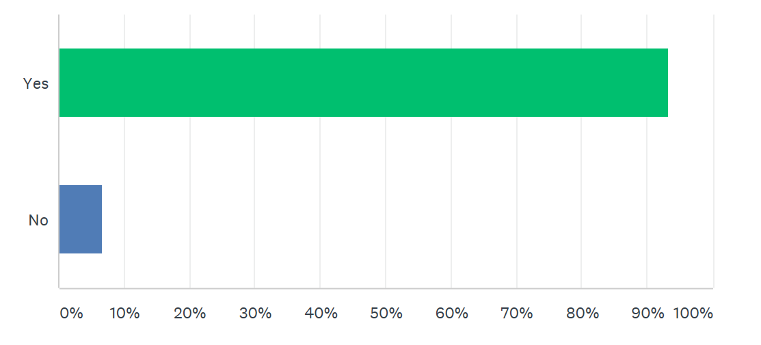
LDSS RESPONSE TO Q#2:

Slide 8
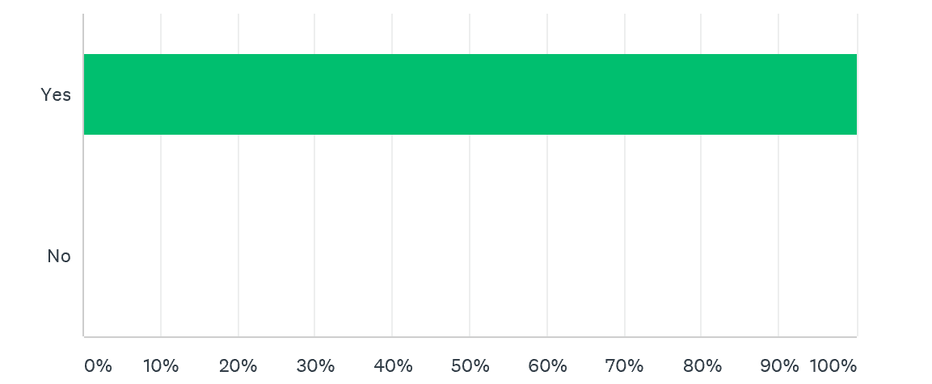
FLESS RESPONSE TO Q#2:

Slide 9
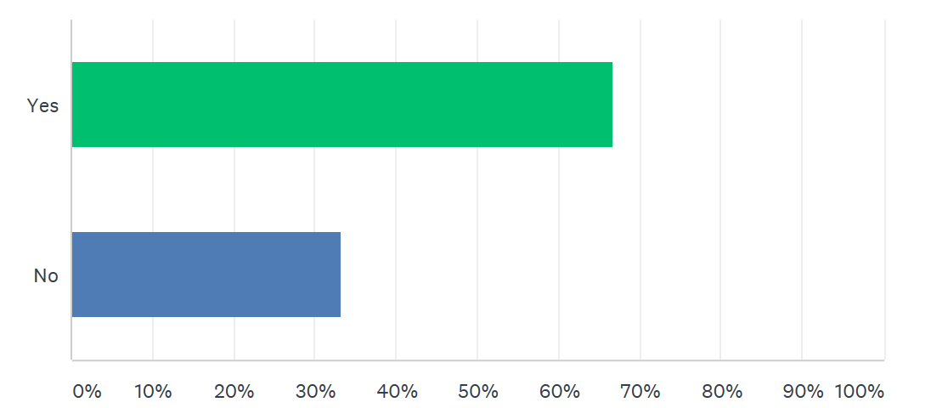
NVSS RESPONSE TO Q#2:
FSJSS RESPONSE TO Q#2:
Debate in group on how rubric should be scored?
Indicative pocket of knowledge: In your own role, through your own lens how do you score? Beginning and end, have you seen change?

Slide 10
LDSS RESPONSES TO Q#3:
Focus staff level of comfort/understanding with Aboriginal Ways of Knowing and First People's Principles - what does that actually look like in practice.
Trying to increase communication, particularly with the teachers and support staff on the front lines.
I think having the students/parents become apart of the decision makers in the Aboriginal Education in the schools. They should be partners somehow, and not just band representatives.
We need certified/qualified Language and Culture teachers in our schools. We also need to find a way to have more parent involvement within the schools.
More communication between stakeholders
More Language and Cultural teaching.
Getting all youth involved and fully aware.
When would this be implemented into the system.

Slide 11
CONTINUATION OF LDSS RESPONSES ON Q#3:
1. Finding ways to get First Nation community members into the schools (so they feel more connected). 2. Having workshops so staff can better learn how to integrate First Nation content into their classrooms.
Getting families involved, and putting time aside for more cultural learning
Forming a cohesive and committed group that represents all partners, that focuses on improving learning environments and policies for all students.
The first step could be Learning Profile. We need support with collecting and reviewing data so we can identify students who need support/intervention. We can have all the policies in place but we need action that connects the dots directly to the learners!
Communication and training to all support workers, that work with Indigenous students. This could definitely help students reach the Graduation target. Pro-d days benefit all professionals whom work with all of our students. Policies and procedures need to be shared with all staff, so they are aware.
I think further study is needed. We need to track individual students from early grades on and identify stumbling blocks and impediments to success. We also need to reach out to districts that have implemented successful responses to these challenges.

Slide 12
CONTINUATION OF LDSS RESPONSES ON Q#3:
Data- elementary learning profile, early intervention- child care programs, communication
Culture changing practice, learning profile, data collected for support and interventions
AIMS overview- RTI Support
Aboriginal Education specific- confirms date, CUPE, time sensitive.
Language and Culture:
First Voices
6 Different Dialects, languages.
You Tube: alphabet, numbers, 1-10
Cheslatta Dictionary
IRP Solid skeleton, Where is that?
Pilot: Nedut’en- student driven, utilize equipment
Wed: Humanities, how do we preserve story? Connections?

Slide 13
FLESS RESPONSES TO Q#3:
Finding ways to connect school with community. Building a strong relationship would address many of the challenges we face as a system. Communication/Understanding, language, culture etc.
Better understanding and integration of the First People's Principles of Learning could be valuable.
Continue to develop mechanisms to increase involvement between the stakeholder groups
Parents along with the teachers can help build the students confidence And find their inner strengths, thus will help them find themselves and they will take their confidence and succeed.
Notes:
PVP Survey: Teachers work on community connectedness, find out from communities what works?
First of meetings- Stellat’en, follow up meetings and making a committee

Slide 14
NVSS RESPONSES TO Q#3:
More parental involvement
Working with local communities
I think that stronger efforts to involve community would be an impactful change. As schools and educators work to embed Aboriginal Worldview into curriculum and learning, the involvement of local FN community members build relationships and creates authentic learning experiences for learners. I also think that more staff (CUPE included) need to be aware of FPPL via professional development.
More training
Make whole day for all staff mandated Pro-D

Slide 15
FSJSS RESPONSES TO Q#3:
Sharing the results of the data with the school community. If we share this information we can educate and communicate with all stakeholders and move forward together.
More communication with all stakeholders of a coherent policy.
Communication about what is happening in our District
How people can become involved?
Research
Grade 4 and 5
Shift from primary to intermediate
Satisfaction Survey
Elementary PVP: Share point, learning profile, survey.
Parent Teacher meetings (Kwah Hall)
Successful practices

Slide 16
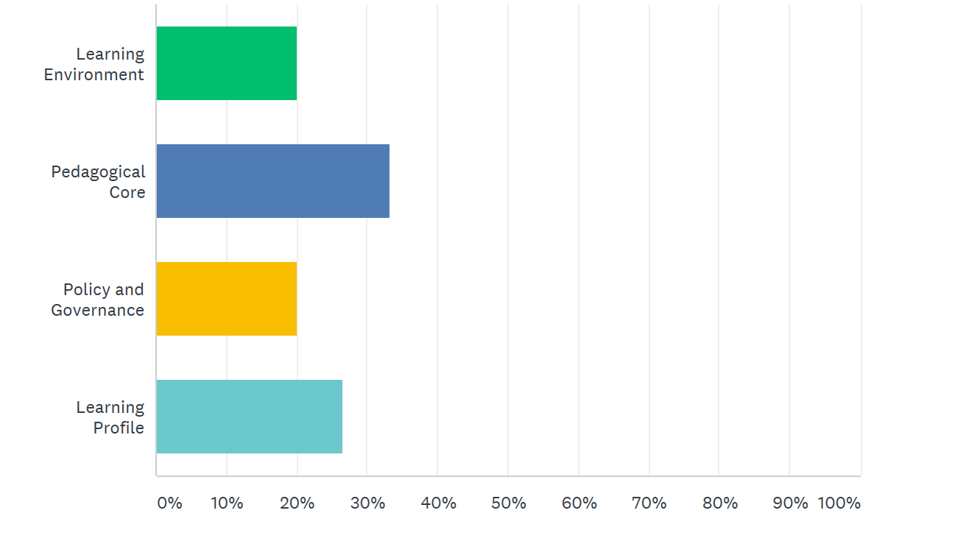
LDSS RESPONSE TO Q#4:

Slide 17
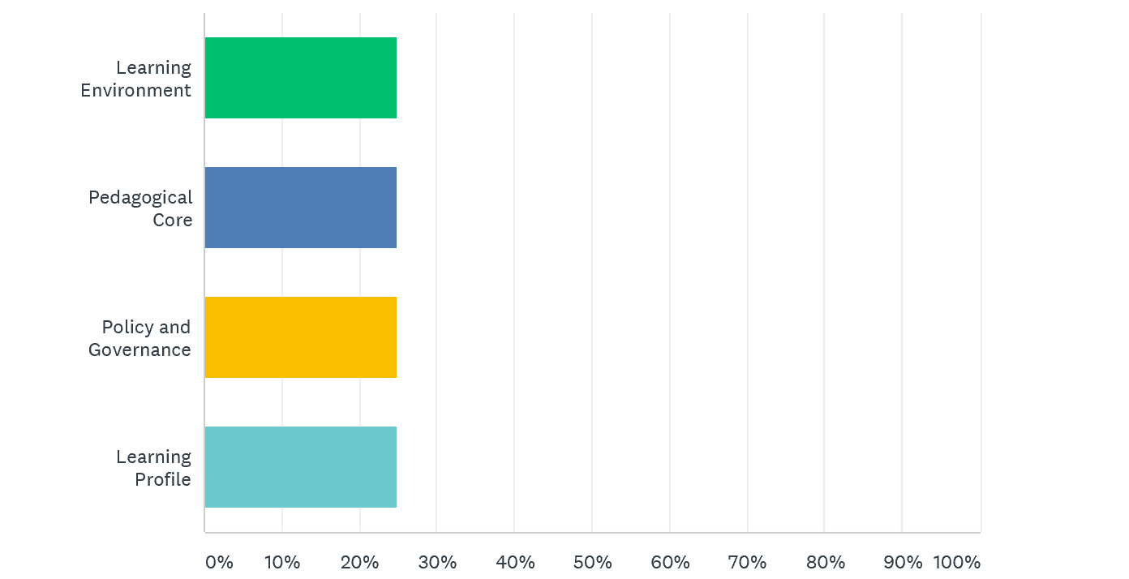
FLESS RESPONSE TO Q#4:

Slide 18
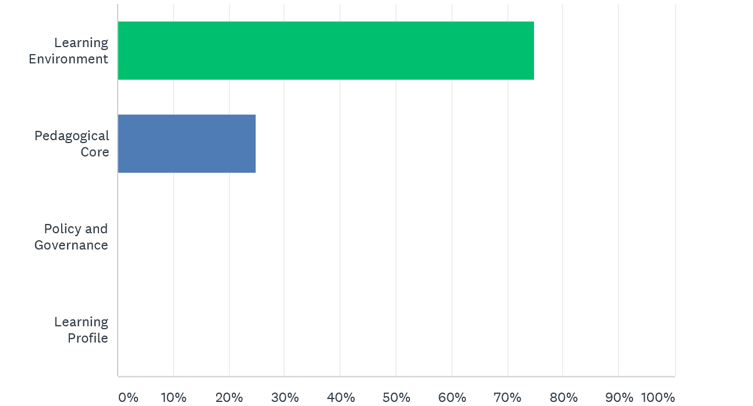
NVSS RESPONSE TO Q#4

Slide 19
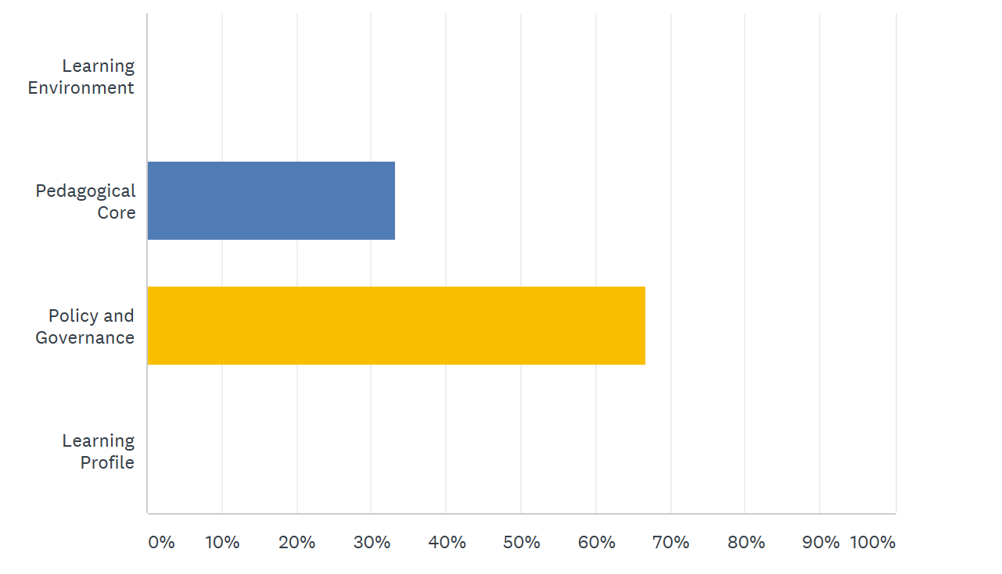
FSJSS RESPONSE TO Q#4

Slide 20
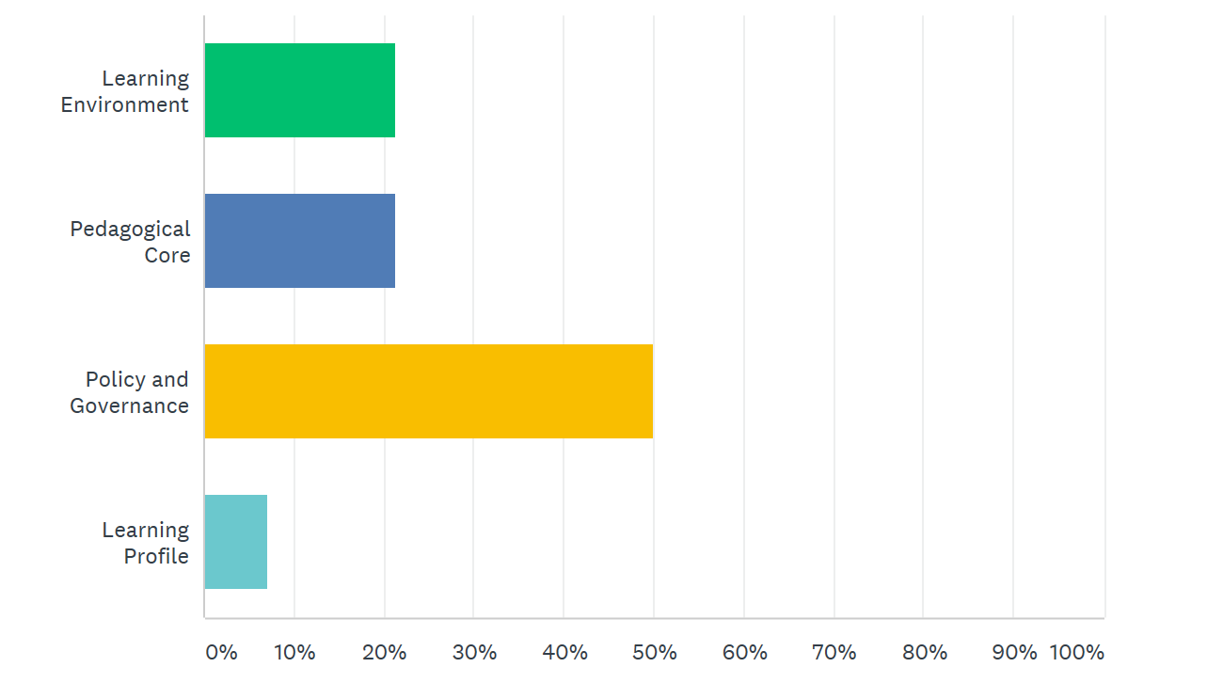
LDSS RESPONSE TO Q#5:

Slide 21
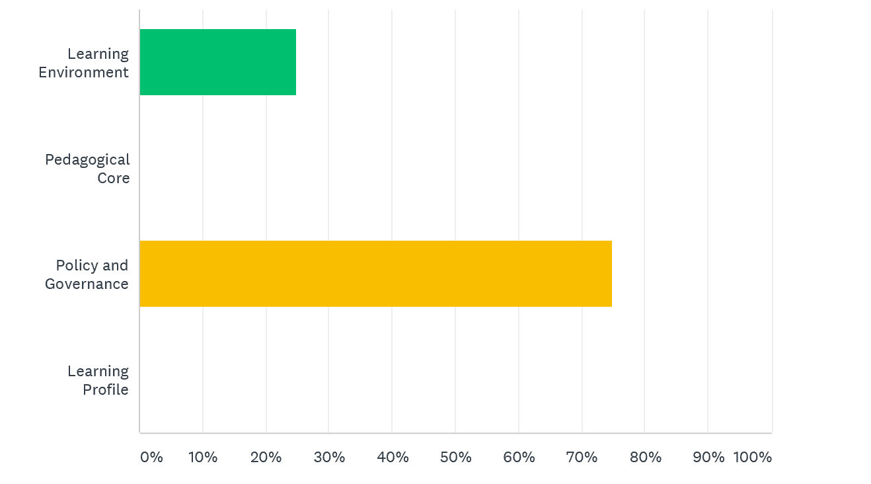
FLESS RESPONSE TO Q#5:

Slide 22
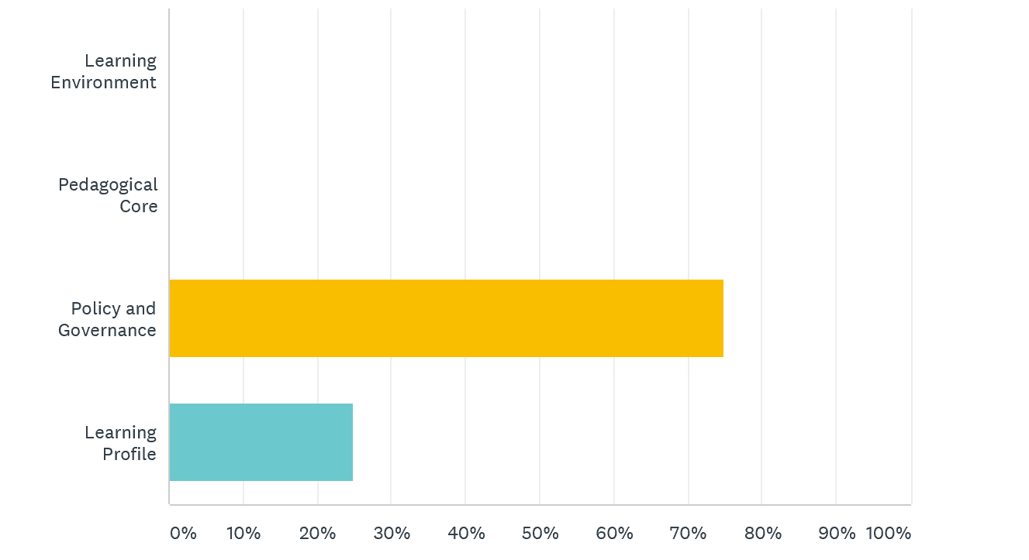
NVSS RESPONSE TO Q#5:

Slide 23
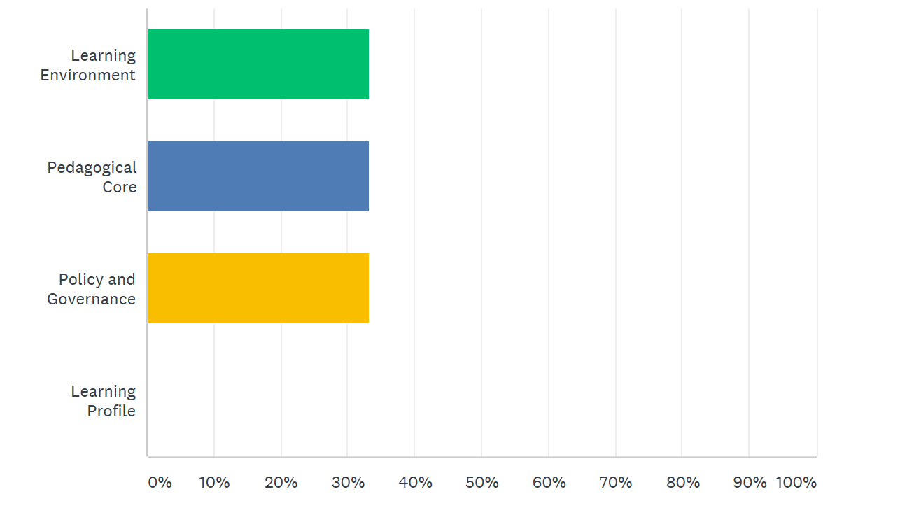
FSJSS RESPONSE TO Q#5:

Slide 24
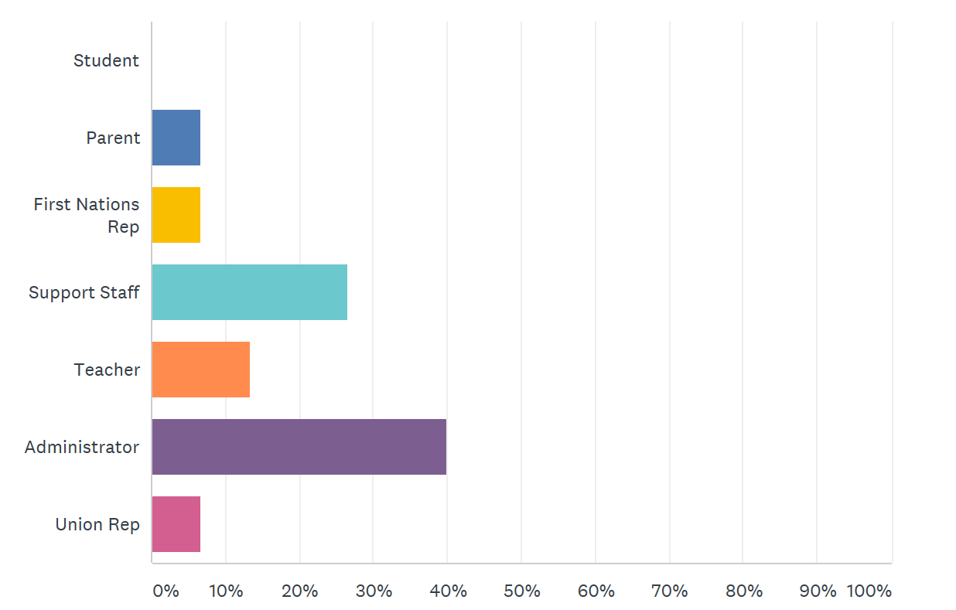
LDSS RESPONSE TO Q#6:

Slide 25
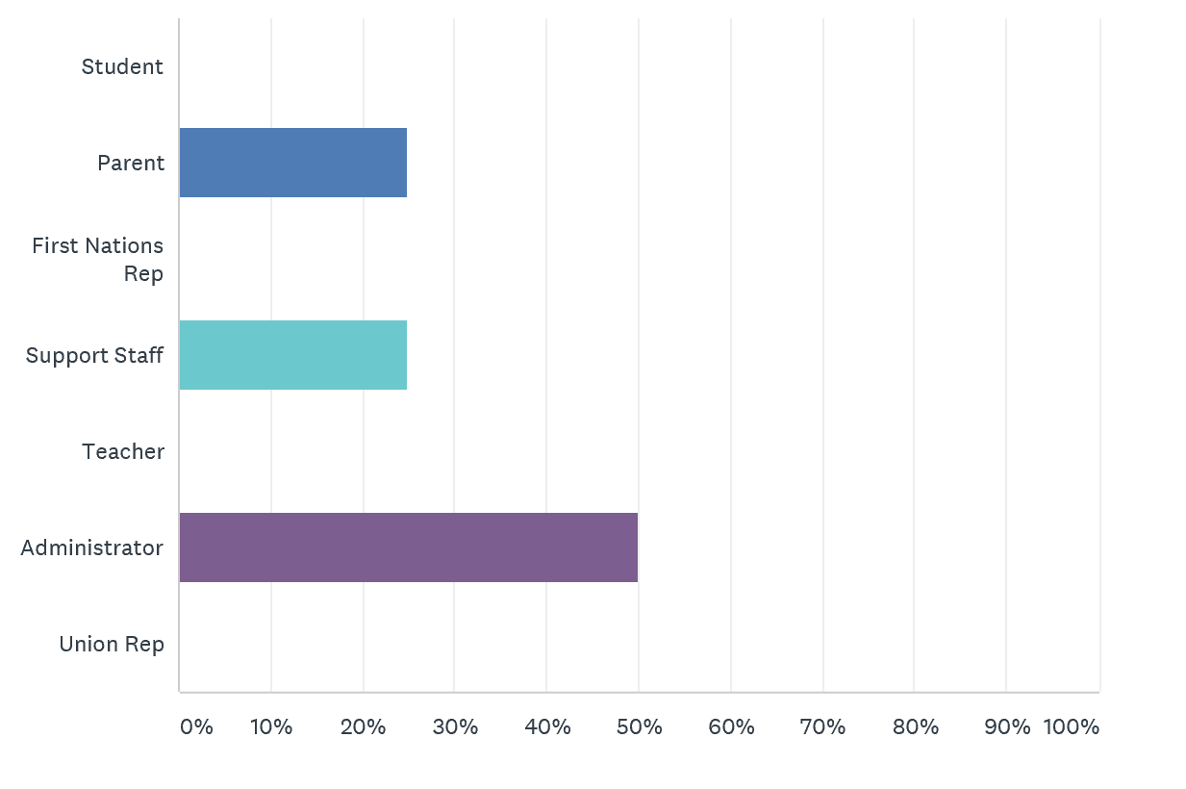
FLESS RESPONSE TO Q#6:

Slide 26
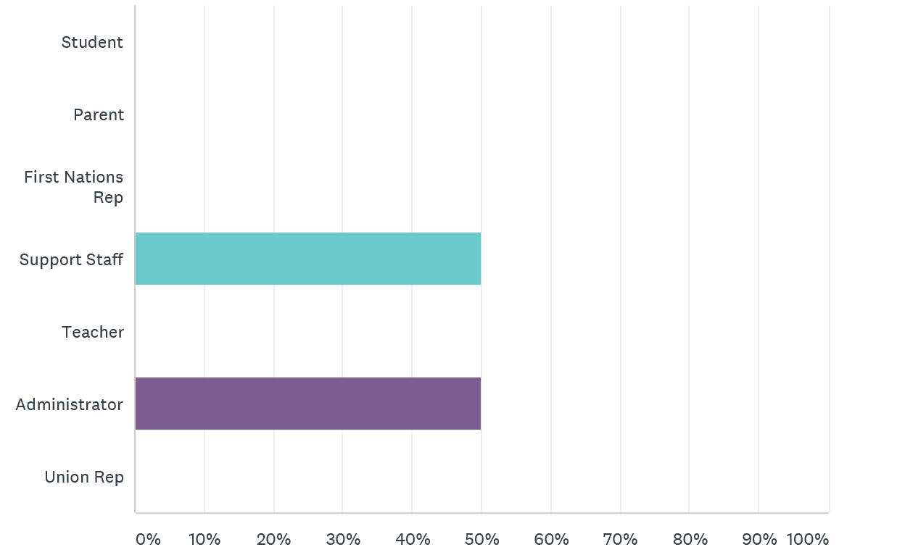
NVSS RESPONSE TO Q#6:
Ken: Capstone seem less? How are we meeting all the needs? At risk kids? ELA 12? Will it impact graduation rates?

Slide 27
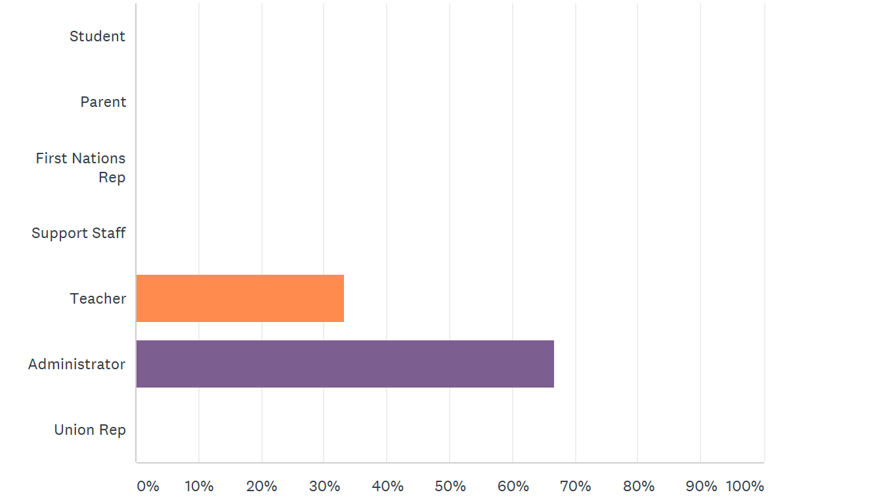
FSJSS RESPONSE TO Q#6:

Slide 28
LDSS RESPONSES ON NEXT STEPS AND ACTION PLAN:
Next Steps: Theory of Change
Professionalism and working with children
These are the kids we have, how do we move them forward?
Communication- high expectations
Connectedness and relationships
Action Plan:
Increase culture and language
Values undermining structure
Accountability of all parties in equity scan. What is your role? Are you accountable?
Painting a picture of where kids are at and where we want them to be
What have I done or not done?
Own this collectively, cannot be another exercise and study about how our…
In order to extend our roots of reconciliation and build upon our successes, we will need to increase our value that all people can be successful and have accountability to our children.

Slide 29
FLESS RESPONSES ON NEXT STEPS AND ACTION PLAN:
Next Steps: Theory of Change
Traditional learning: community, school and land.
Invitation to knowledge holders.
Culture and Language
Action Plan:
Have FNEC Calendars included on calendar portal.
Head Start- Nadleh Language event.
Head Start- Stellat’en Toddlers Language Nest.
Grade 10 Teacher.
Strengthen relationships
More hands on, more out of the classroom (FPPL)
Place-Based learning experiences (Sarah John, Math NVSS)
Knowing the reasons you are learning, relevancy.
Gap with parents and schools, connect with Aboriginal Education Staff
Comfort within school
HSC included more, more connections in the community.
Strengthen student relationships with teachers, friends and family so they have enough support
Need more thorough teaching.

Slide 30
NVSS RESPONSES ON NEXT STEPS AND ACTION PLAN:
Next Steps: Theory of Change
Using tools to connect students and families in an authentic way Connection to community and culture, already connecting with Saikuz
Using learner profiles
Developing authentic relationships
Action Plan:
Persistence with community
Personal contact with students and families.
Connections with family
Increase school and family relationships including the personal and understand where people are at
Authentic relationships
Authentic conversations
Explore new things

Slide 31
NVSS ADDITIONAL NOTES:
Equity scan, teacher leads, meeting, how do they facilitate?
Pull all data and send to schools
May schedule equity scan district team meeting
NVSS 9 &10 middle years ends at 8
Rescheduling
My Ed data lists to team
FSJSS RESPONSES ON NEXT STEPS AND ACTION PLAN:
Next Steps: Theory of Change
Foundational- 4 Clans
Not fit a model of change
Four Seasons Model
Watershed Model
Collecting our voices, shifting our narratives
Action Plan:
Salmon Restoration
Honoring Perspectives
Clan meanings by nation? Responsibilities?
Research a doorway into our schools (for parents)

