Slide 1
Equity Scan: Theory of Change and Action Planning Session
FSJSS Family of Schools – March 21, 2019

Slide 2
We have room to grow and improve.
Not a lot of coherence in the data I wonder if the higher rubric scores are related to a positive feel for the work of the schools
We have some good things in place. Communication about what is going on is lacking. Informal practice only in some areas...and policy only in others.

Slide 3
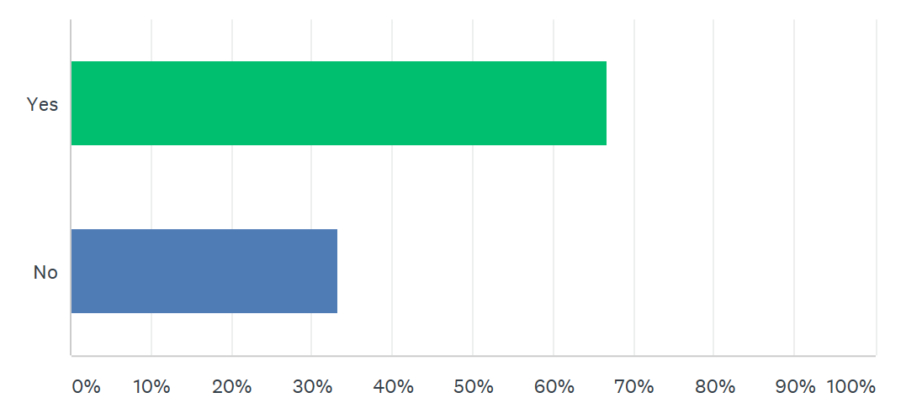

Slide 4
Sharing the results of the data with the school community. If we share this information we can educate and communicate with all stakeholders and move forward together.
More communication with all stakeholders of a coherent policy.
Communication about what is happening in our District

Slide 5
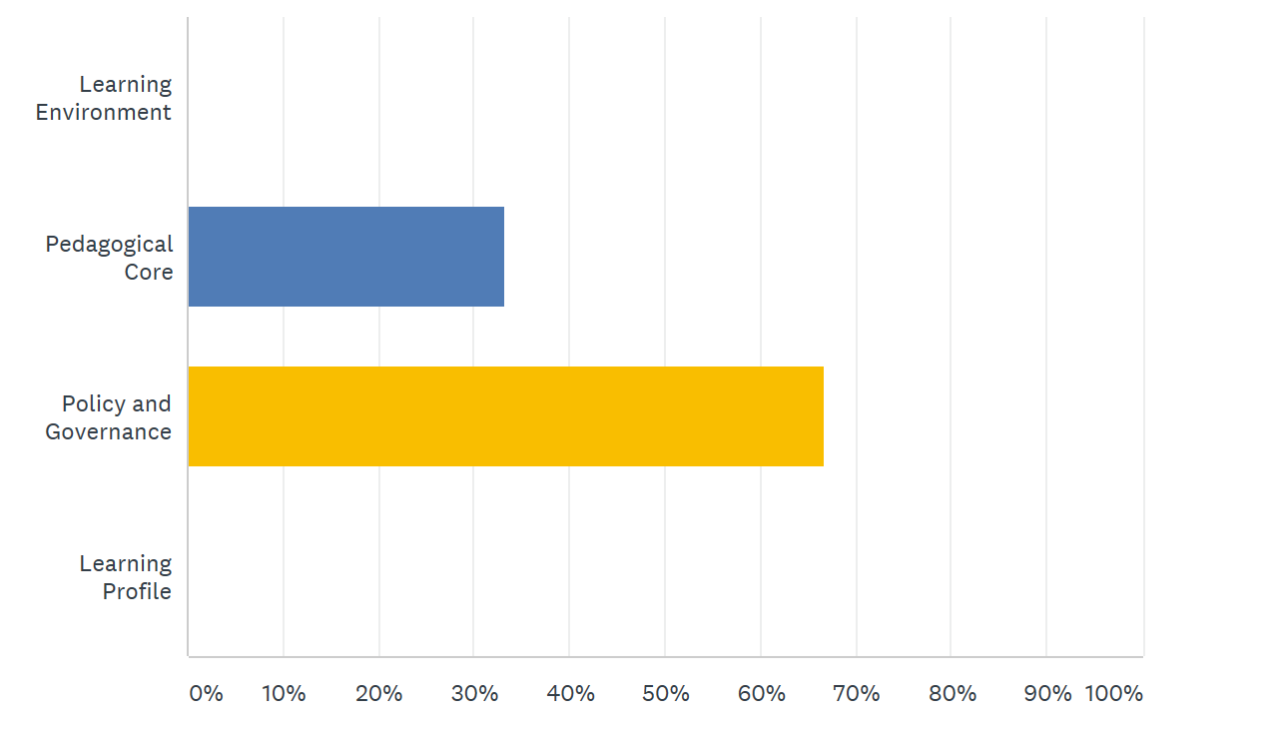

Slide 6
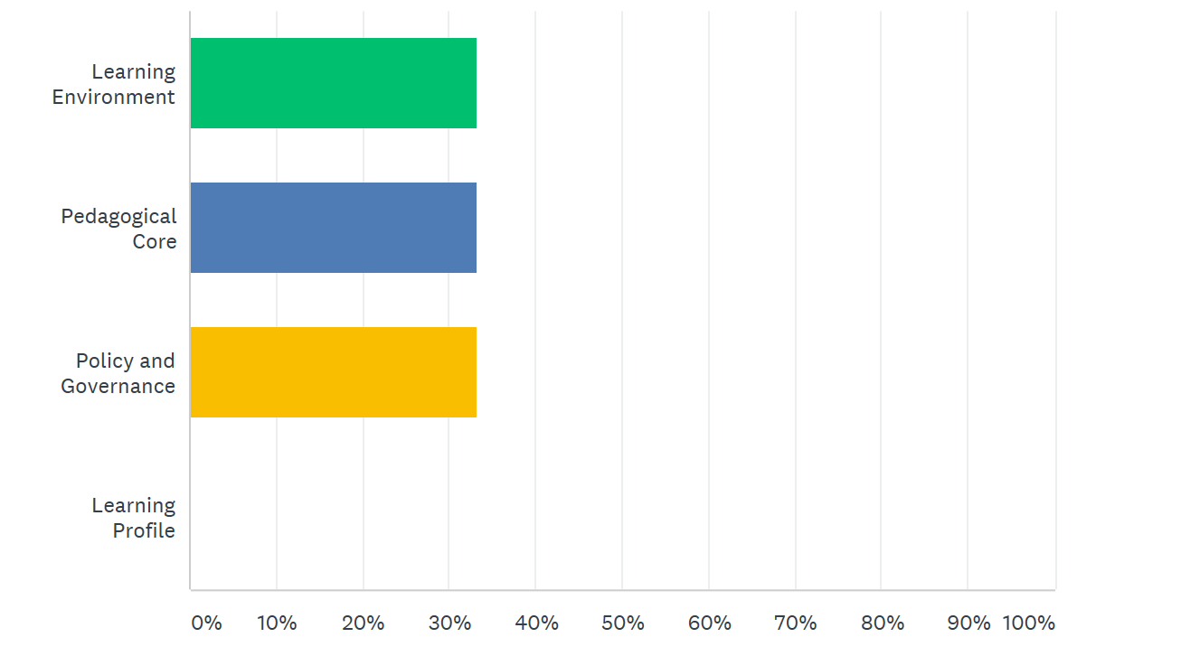

Slide 7
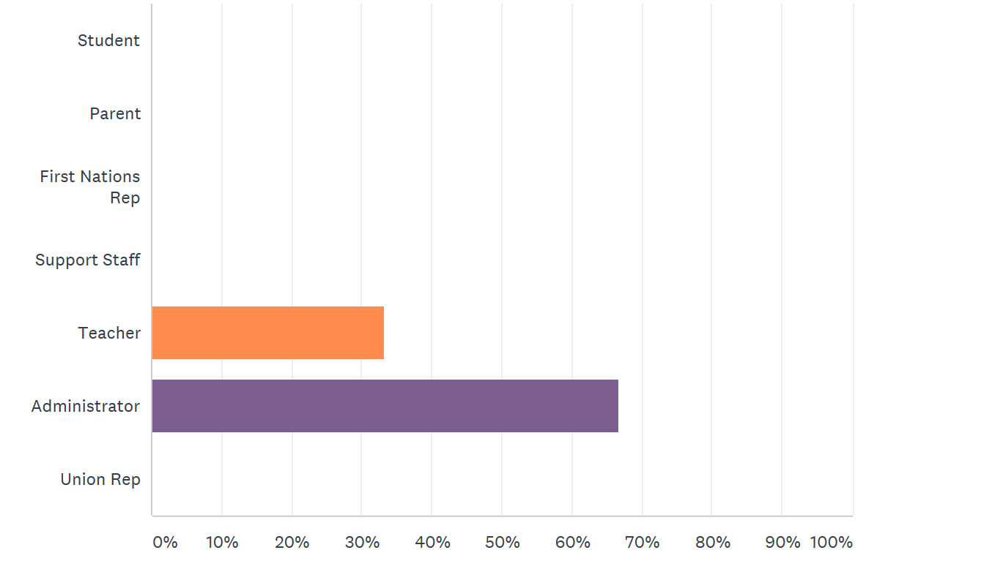

Slide 8
Next Steps: Theory of Change
____________________________________________________________________________________________________________________________________________________________________________________________________________________________________________________________________________________________________________________________________________________________________________________________________________________________________
Action Plan:
______________________________________________________________________________________________________
______________________________________________________________________________________________________
______________________________________________________________________________________________________
______________________________________________________________________________________________________
______________________________________________________________________________________________________

